Slide 1

tickerteller
Technical analysis and forecasting made simple.
team twenty-nine
Pratik, Taruni

Slide 2
Introduction
A snapshot of the project objectives, overview and methodologies.

Slide 3
Objectives: Two Main Ideas
Analysis
Forecasting
To explore financial time series analysis techniques by doing a case study on a company’s stock price data.
To build a tool which could be used for forecasting any company’s stock price.

Slide 4
Overview: Two Main Components
Case Study
Finished Product
A raw case study and breakdown of Amazon’s recent stock performance.
Tickerteller: A web app for stock price forecasting, along with tools for technical analysis.

Slide 5
Methodology: Two Main Approaches
Technical Analysis
Web Application
A detailed financial technical analysis presented as a jupyter notebook using libraries such as pandas, yfinance, ta and matplotlib.
A web application built in streamlit with features powered by yfinance, ta, prophet, matplotlib and finnhub.

Slide 6
Technical Analysis
A detailed deep dive into Amazon’s recent stock performance.

Slide 7
What is Technical Analysis?
Technical analysis is a method of evaluating statistical trends in trading activity, typically involving price movement and volume.
It is used to identify trading and investment opportunities.
Unlike fundamental analysis, which attempts to evaluate a security's value based on financial information such as sales and earnings, technical analysis focuses on statistical trends to draw conclusions about future price movements.

Slide 8
Questions
What was Amazon's overall stock performance during the years 2020-2023 compared to the broader market?
How did Amazon's stock price trend throughout the years?
What were the major events or news that impacted Amazon's stock price?
What were the most volatile periods for Amazon's stock during the year?
Did Amazon's stock outperform or underperform its own historical averages?

Slide 9
[ Case Study Walkthrough ]

Slide 10
tickerteller
A web app for technical analysis and forecasting.

Slide 11
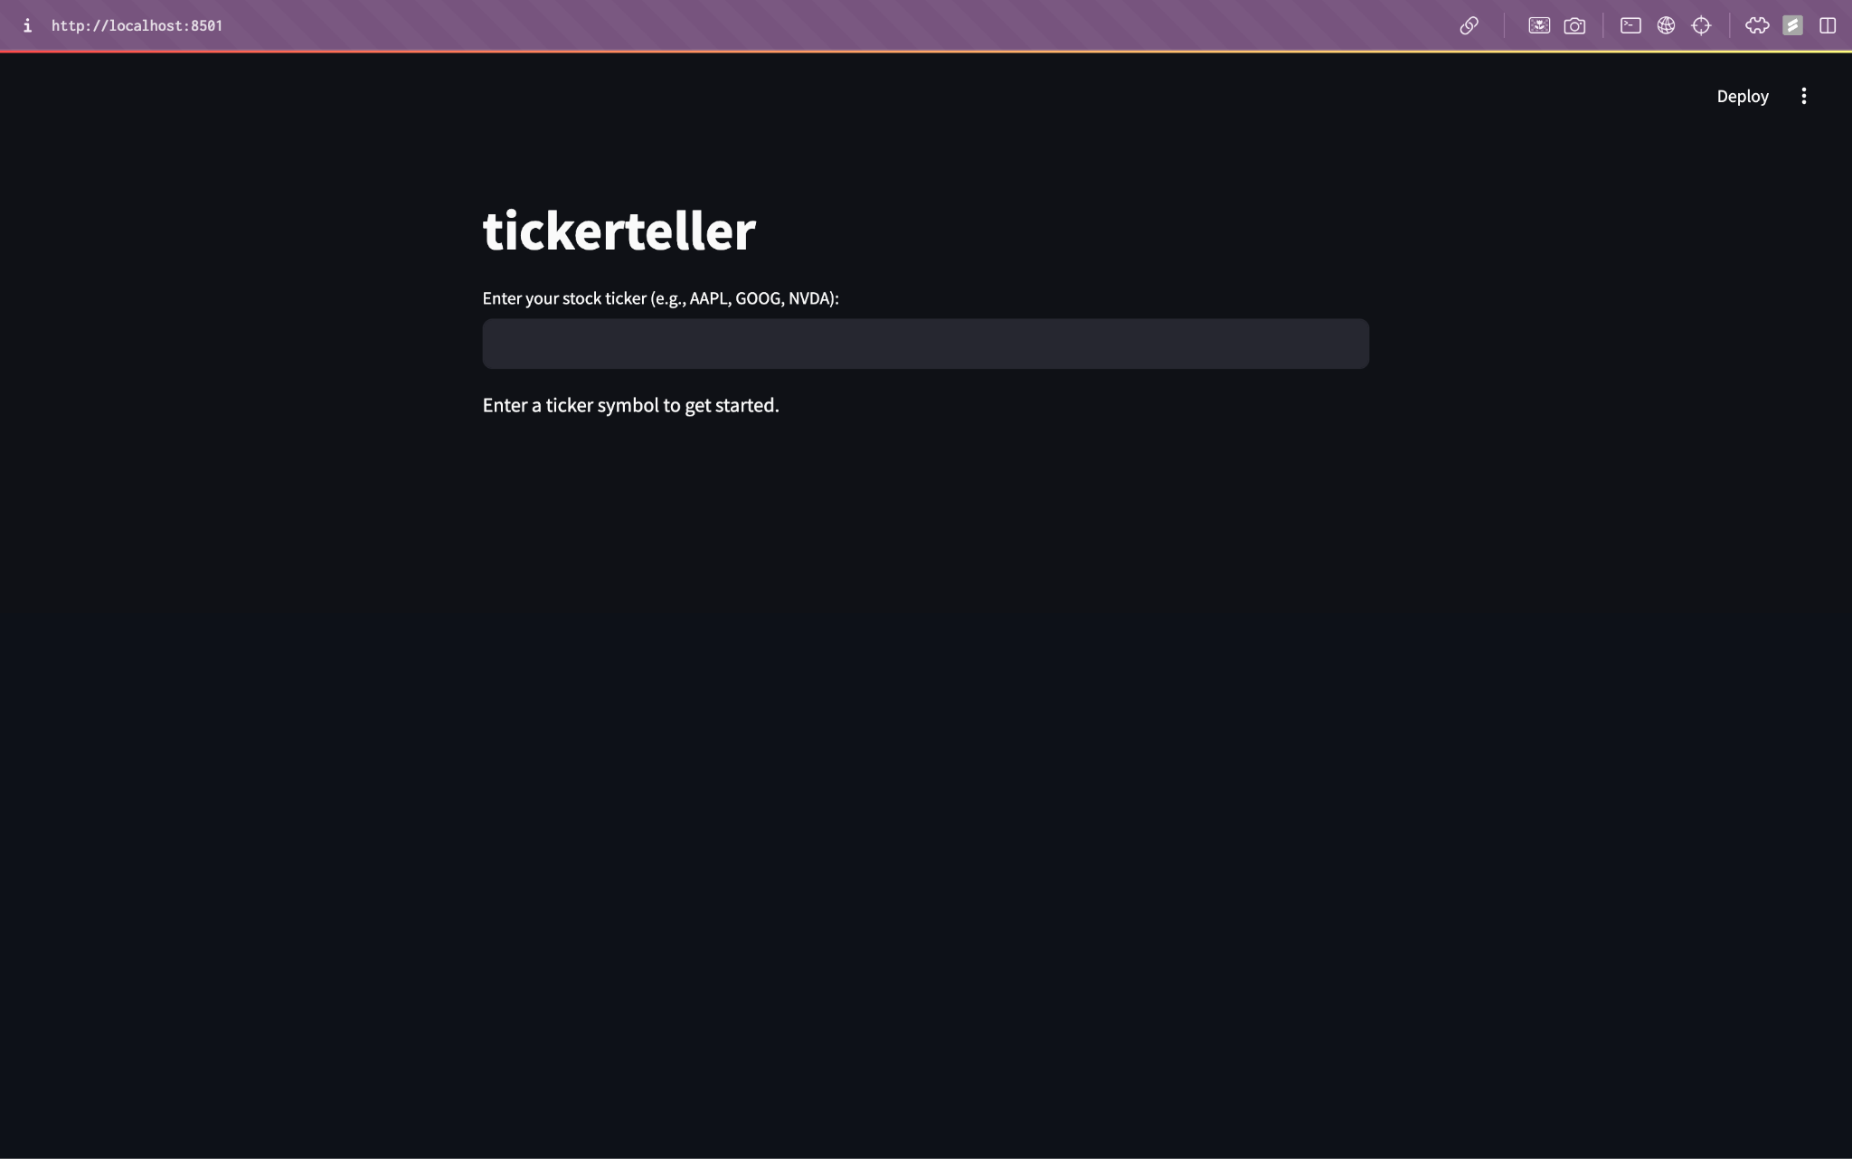
tickerteller
Built in streamlit
Data sourced from yfinance
News courtesy of the finnhub API
Technical Analysis Indicators enabled by ta
Forecasting powered by prophet

Slide 12

Features
Stock Details and News
Technical Analysis Indicators: Trend, Momentum, Volume and Volatility
Forecasting: Look upto 4 years ahead with stock price prediction powered by Prophet

Slide 13
Stock Details and News
A quick glance at the company information and recent headlines.

Slide 14
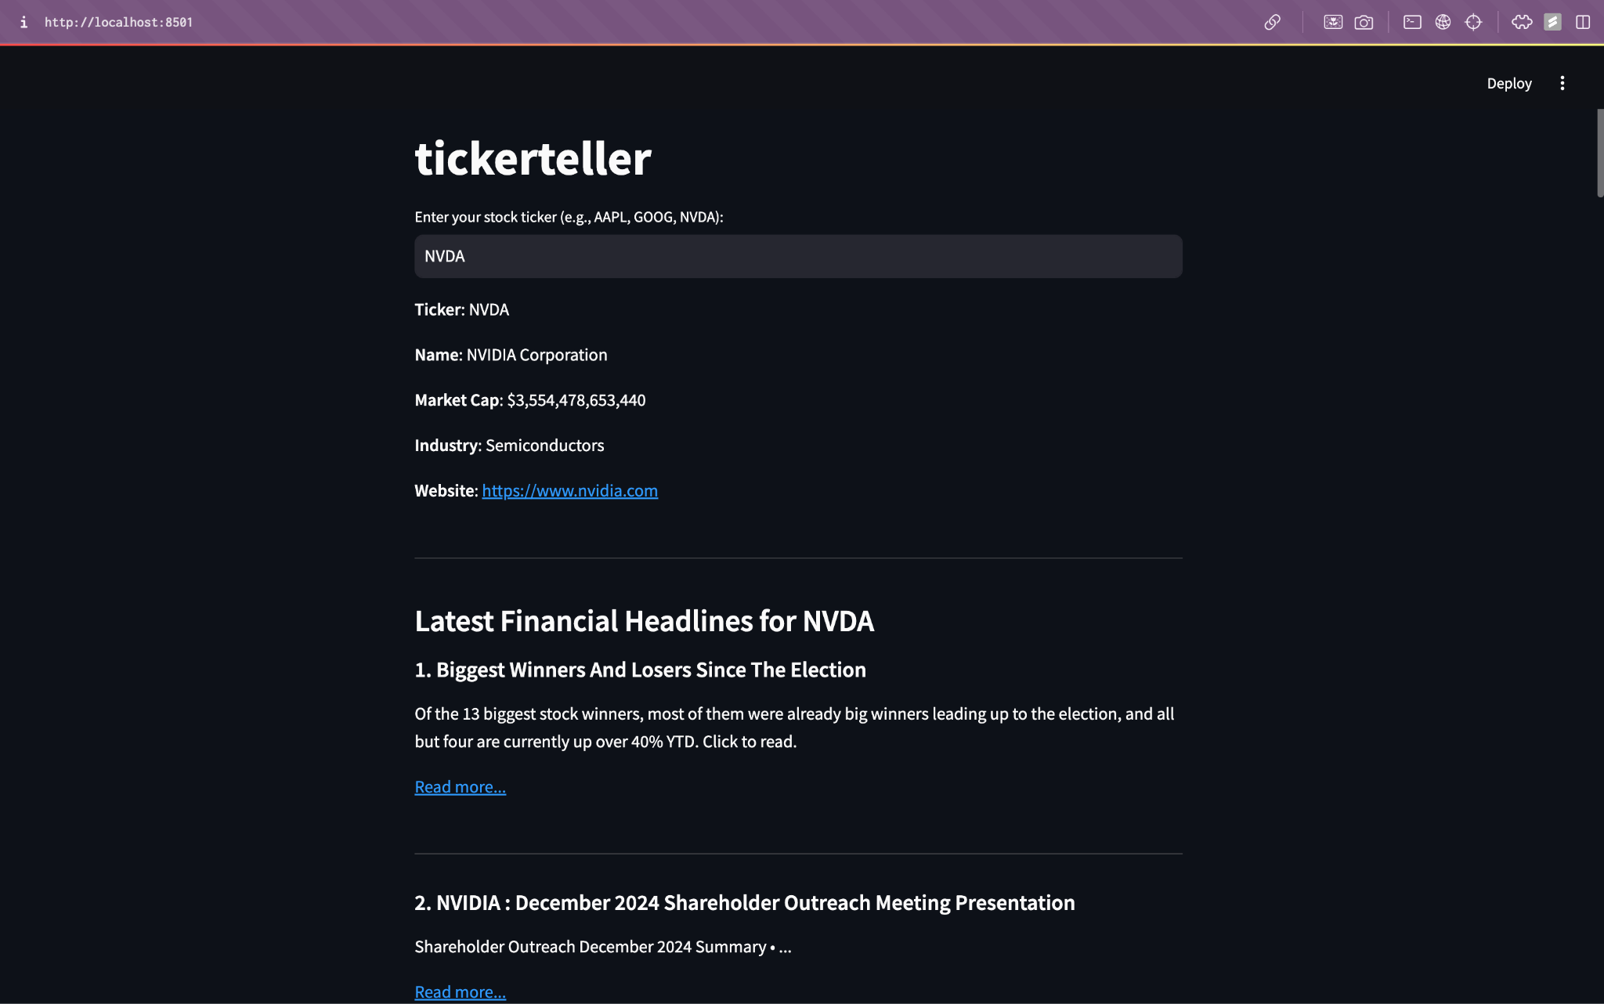
At a Glance: Information and News
Ticker information courtesy of yfinance
News feature powered by finnhub

Slide 15
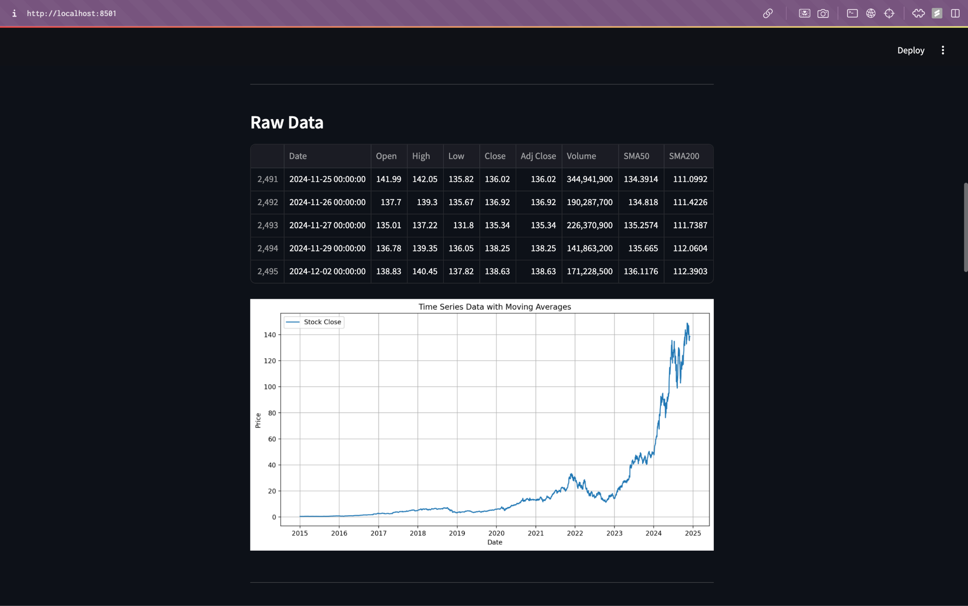
At a Glance: Raw Data and Performance
Raw data pulled from yfinance
Visualization created with matplotlib

Slide 16
Technical Analysis Tools
An overview of all the technical analysis indicators.

Slide 17
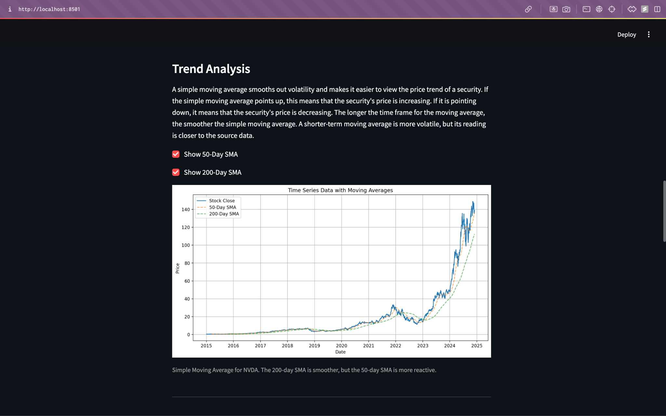
Trend Analysis: Simple Moving Average

Slide 18
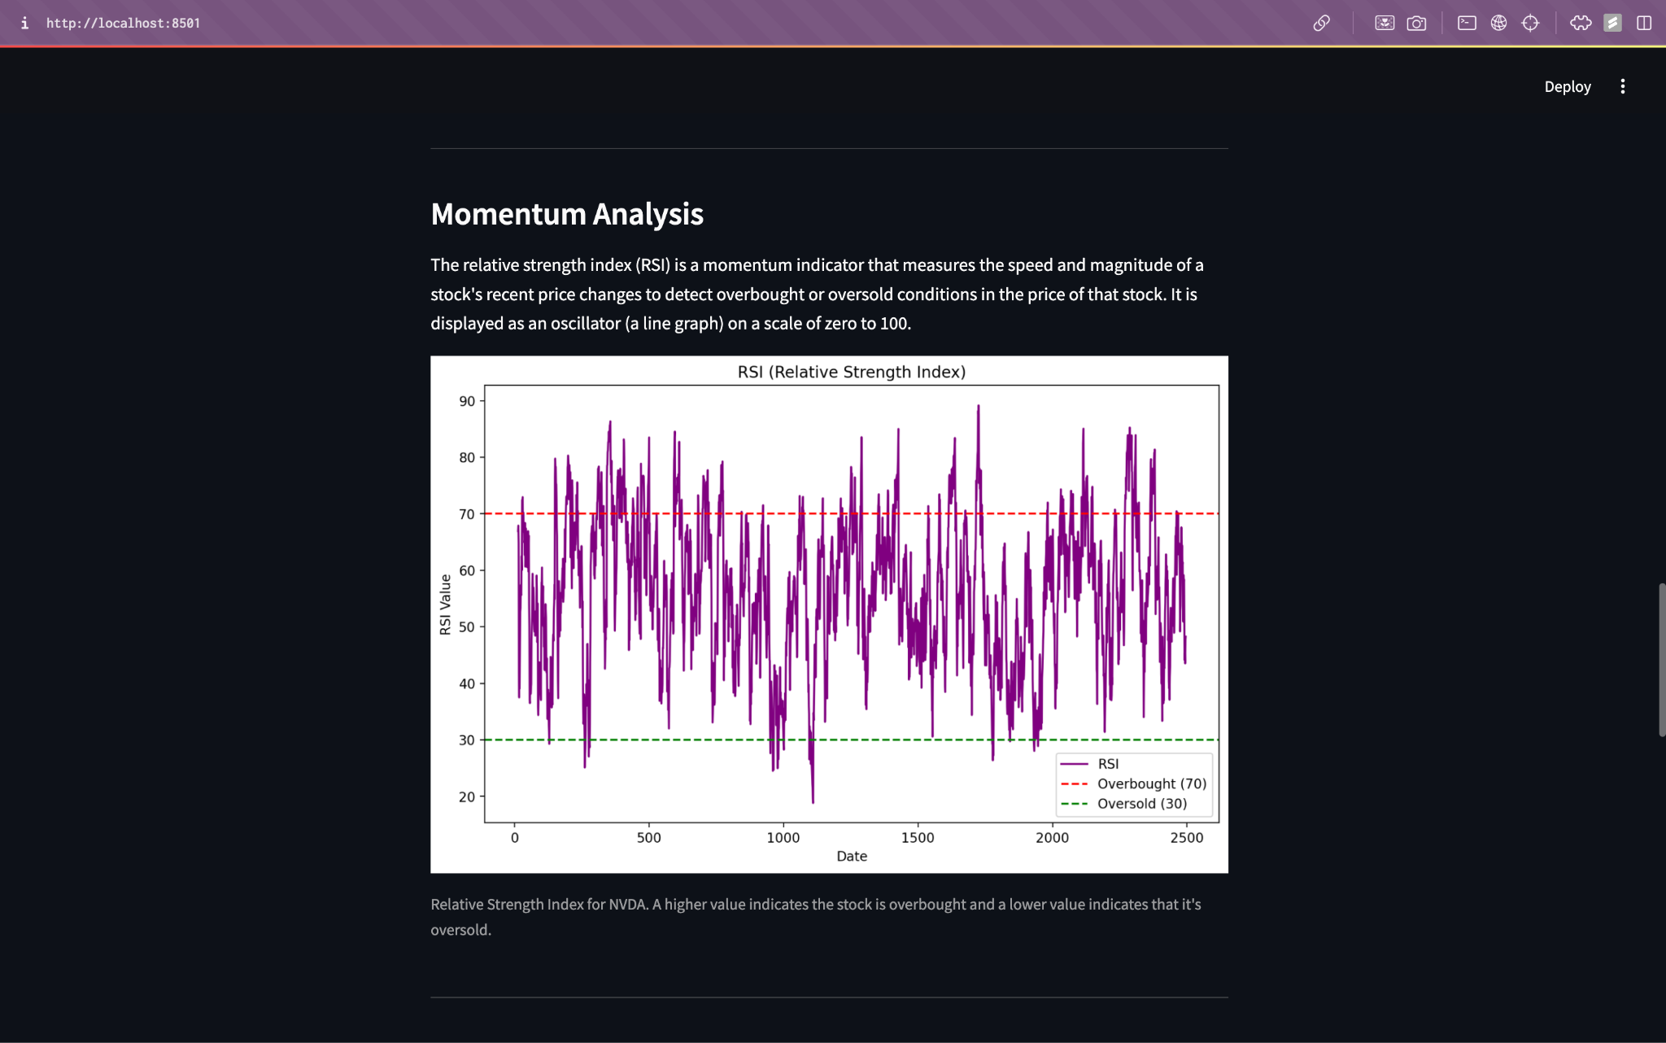
Momentum: Relative Strength Index

Slide 19
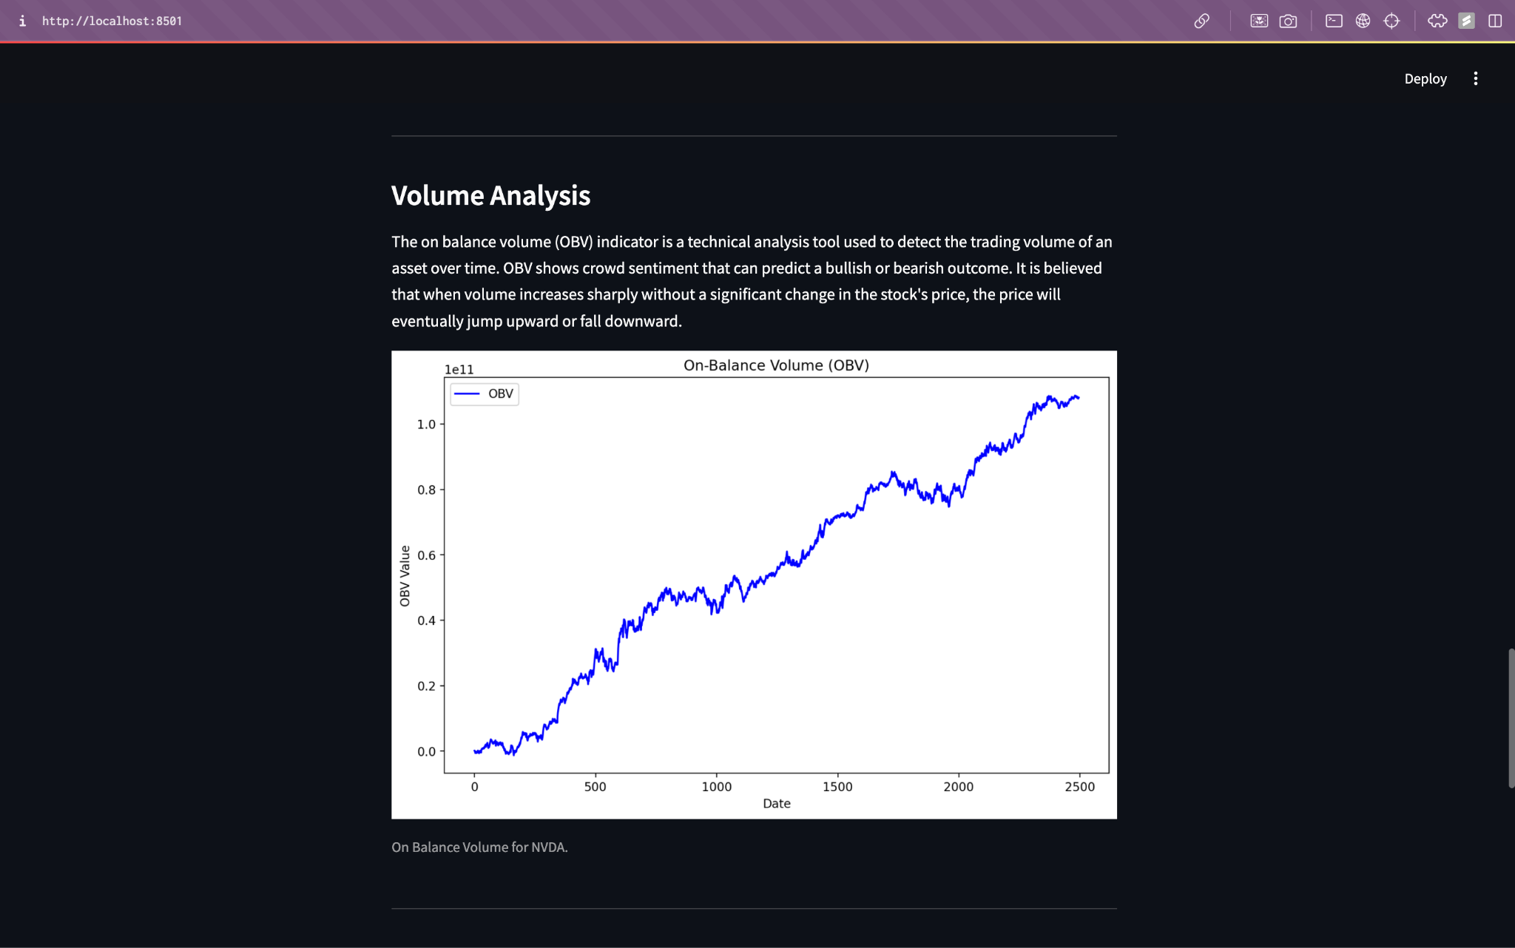
Volume: On Balance Volume

Slide 20
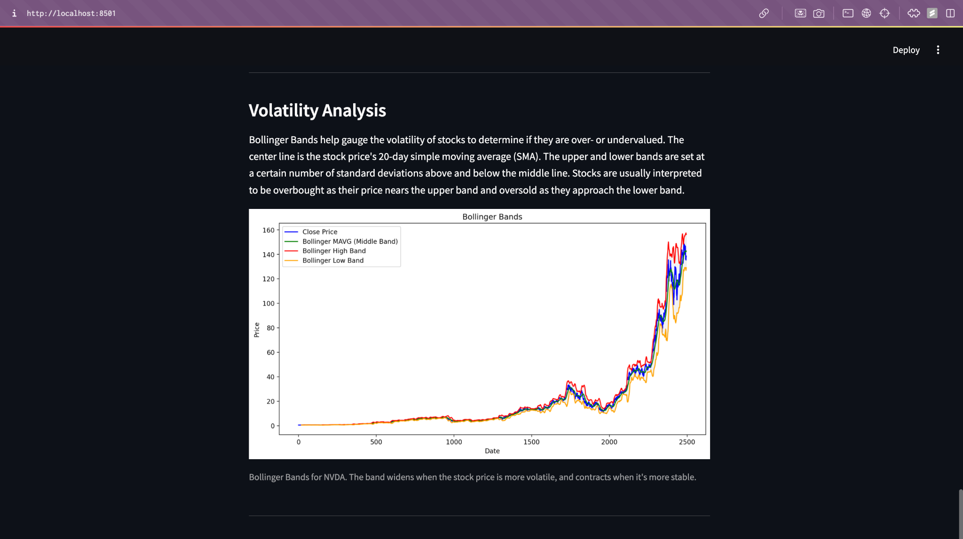
Volatility: Bollinger Bands

Slide 21
Forecasting
An overview of the forecasting capabilities.

Slide 22
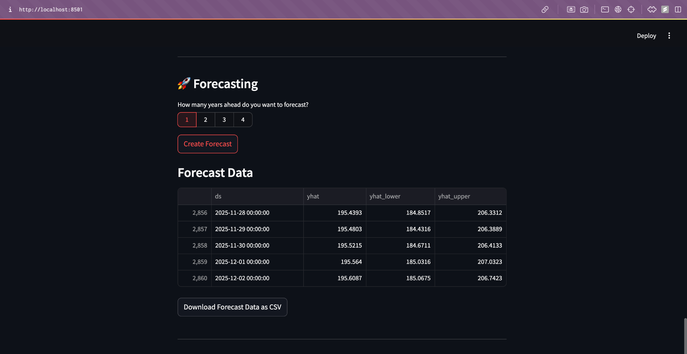
Forecast: Period and Data Download

Slide 23
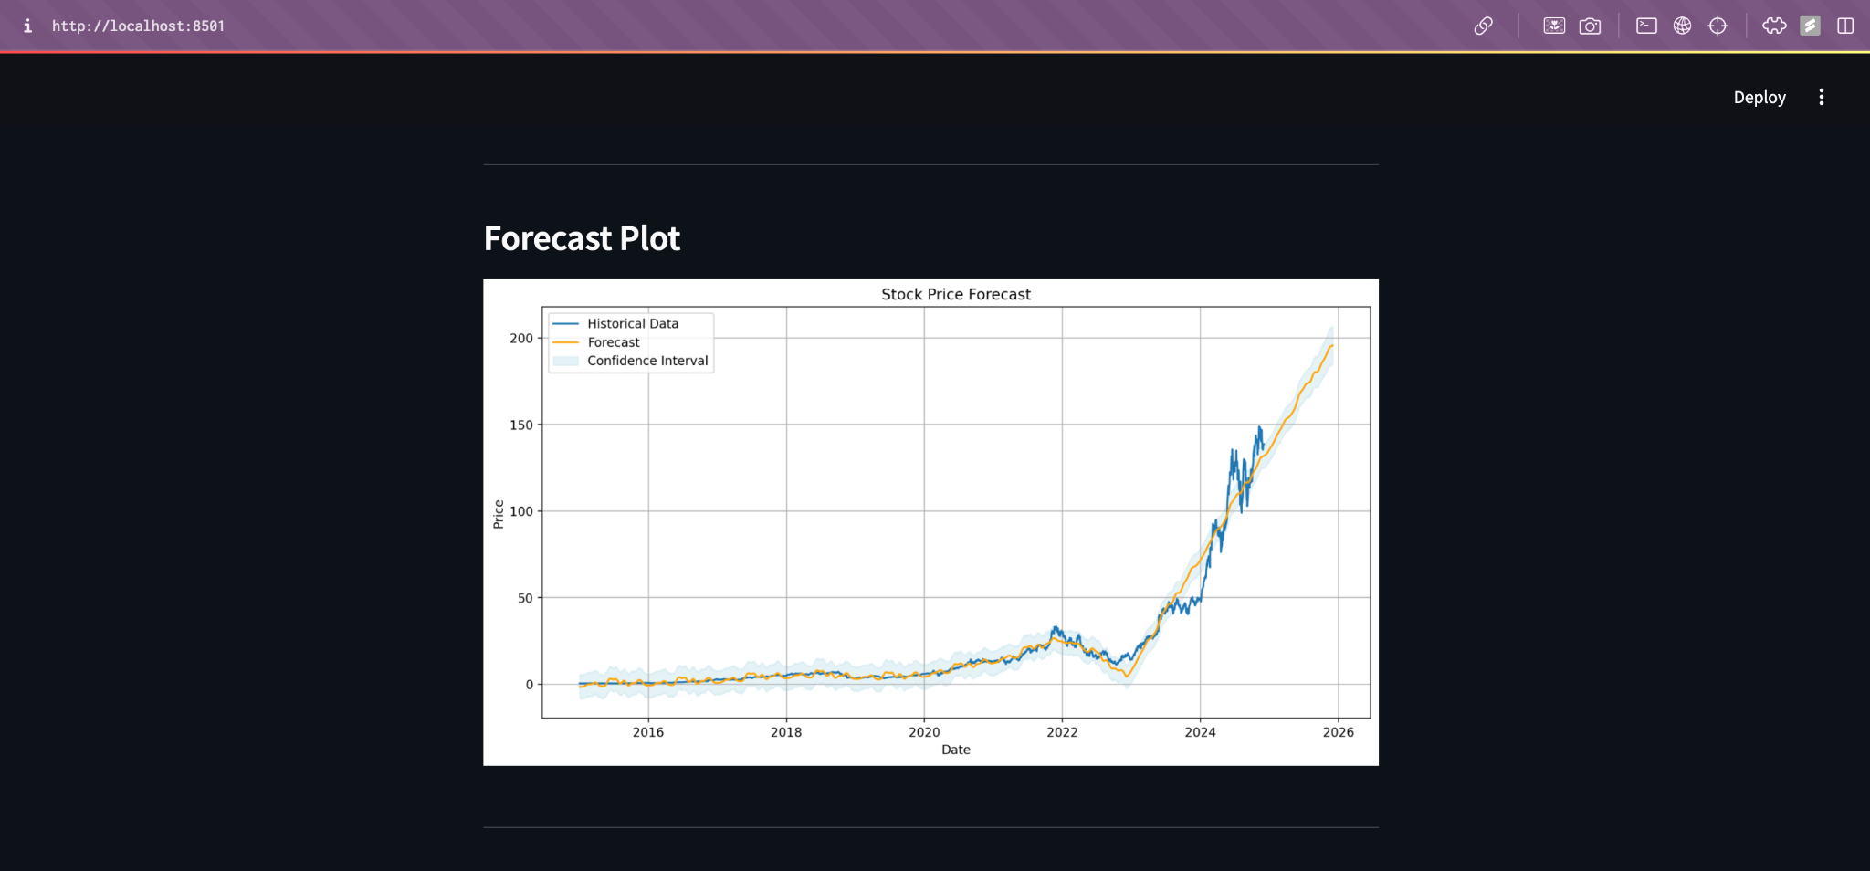
Forecast: Plot

Slide 24
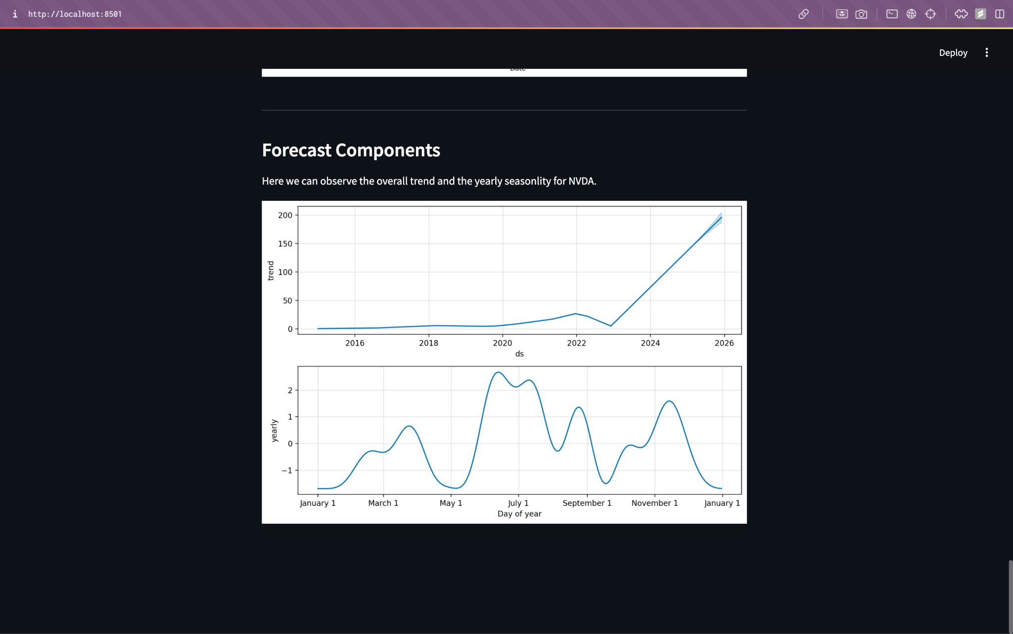
Forecast: Trend and Yearly Seasonality

Slide 25
[ Web App Demo ]

Slide 26
Thank you.

